Slide 2
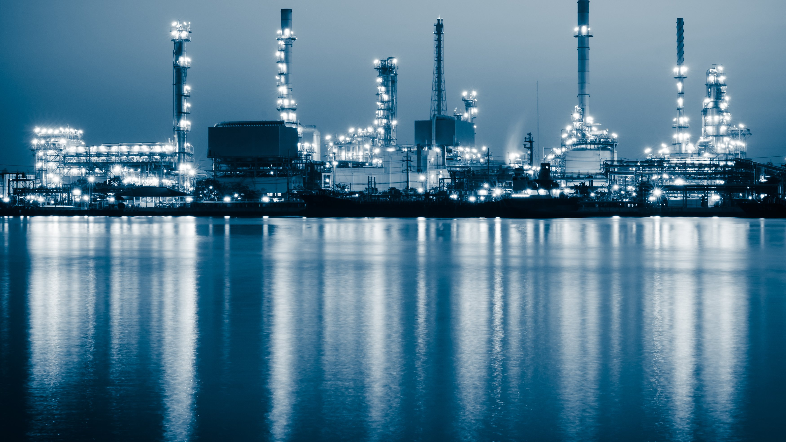
Carbon Based Energy
Pre-Covid to Now

Slide 3

Set the Stage (Crude)
2018 - 2019
$50 - $60 Crude
Focus on Cost Cutting
P/E Looking for Exits
2020
Weakening Prices
COVID
($35) per Barrel Crude in April
10% decrease in demand
Focus on Green. Banks affecting lending
2021
June 2021

Slide 4
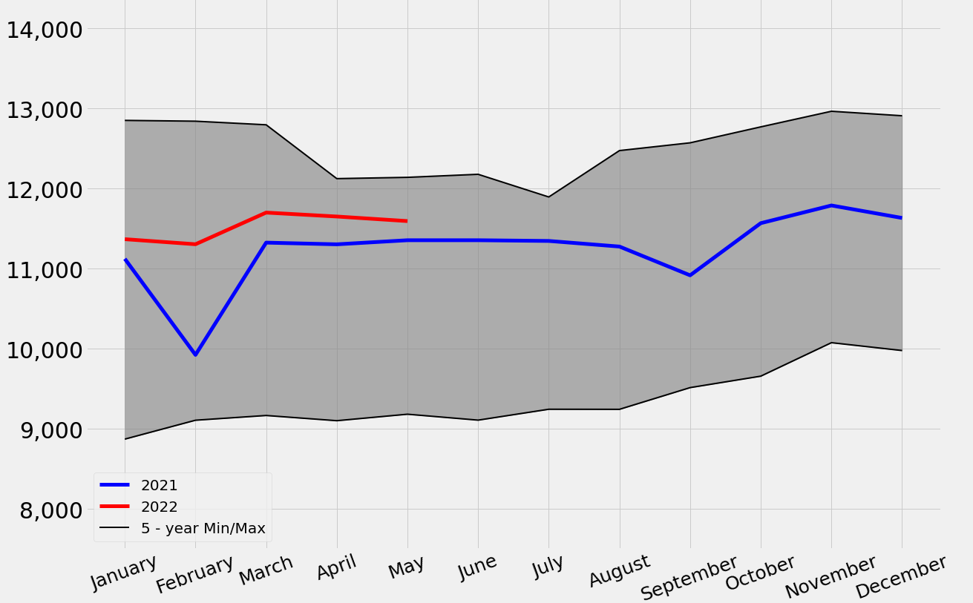
Daily US Oil Production, MBBL/Day
Notes:
Updated for Aug 2022
Max production in 2019. Prices have recovered but production has lagged. Producers have not increased drilling. Hoarded cash for future. The four-week moving average of the recent growth in lower 48 crude oil production is only 250 Mb/d behind 2019 when it was on its way to 12.4 MMb/d by the end of the year. It is not hard to imagine if current high WTI crude oil persists, domestic producers will be able to meet or exceed 2019 levels, given a moderate storm season.
KEY: Other projects in the world are 5-8 year projects

Slide 5
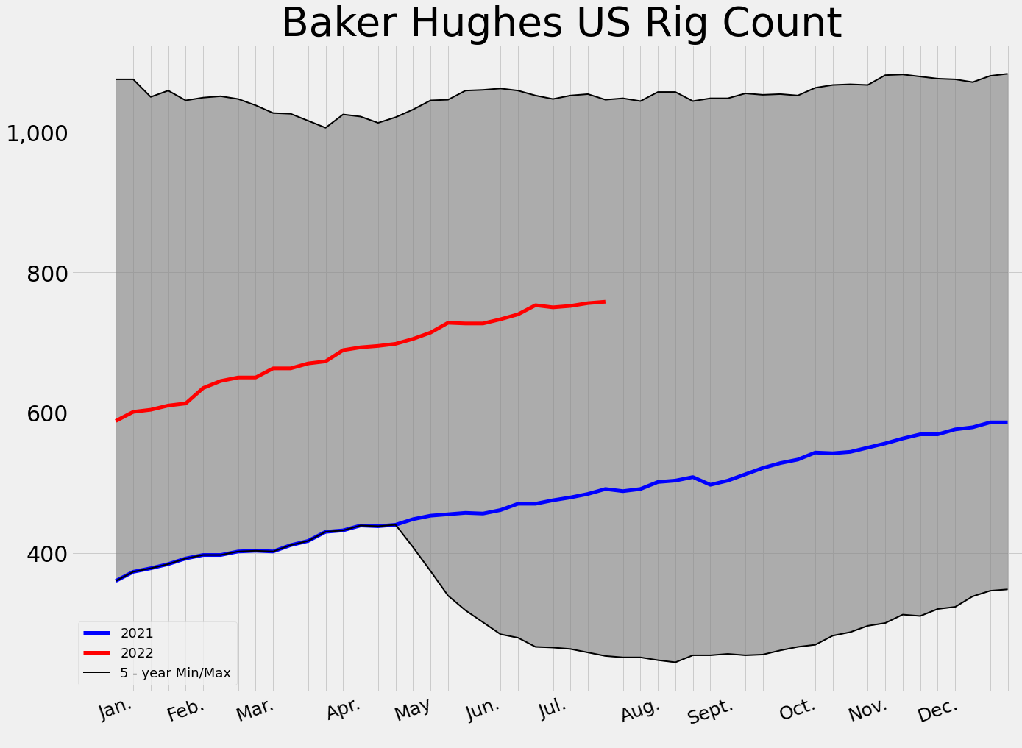
US Total Active Rig Count
Notes:
Updated for Aug 2022
2020 drop in rig count from 800 to 250. Rig count has had slow, steady even linear increase on a week by week basis starting April 2020 through 2021 into 2022. Not the fevered response to price increases we saw in 2014 and 2016. The ratio of rigs increased per $ increase in oil has shifted. From 17 rigs/$ to 7 rigs/$.

Slide 6
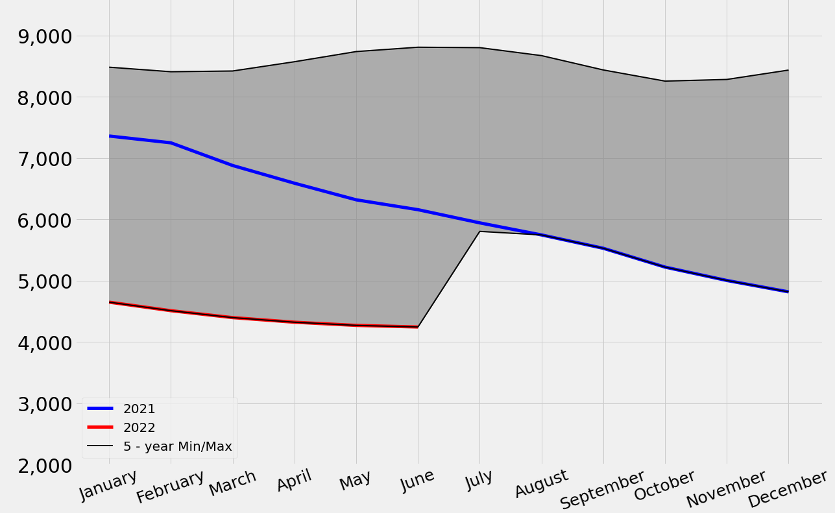
DUC Wells
Notes:
Updated for Aug 2022
DUC inventories near our natural floor. So our drilled inventory is almost out. Drilling will need to increase

Slide 7
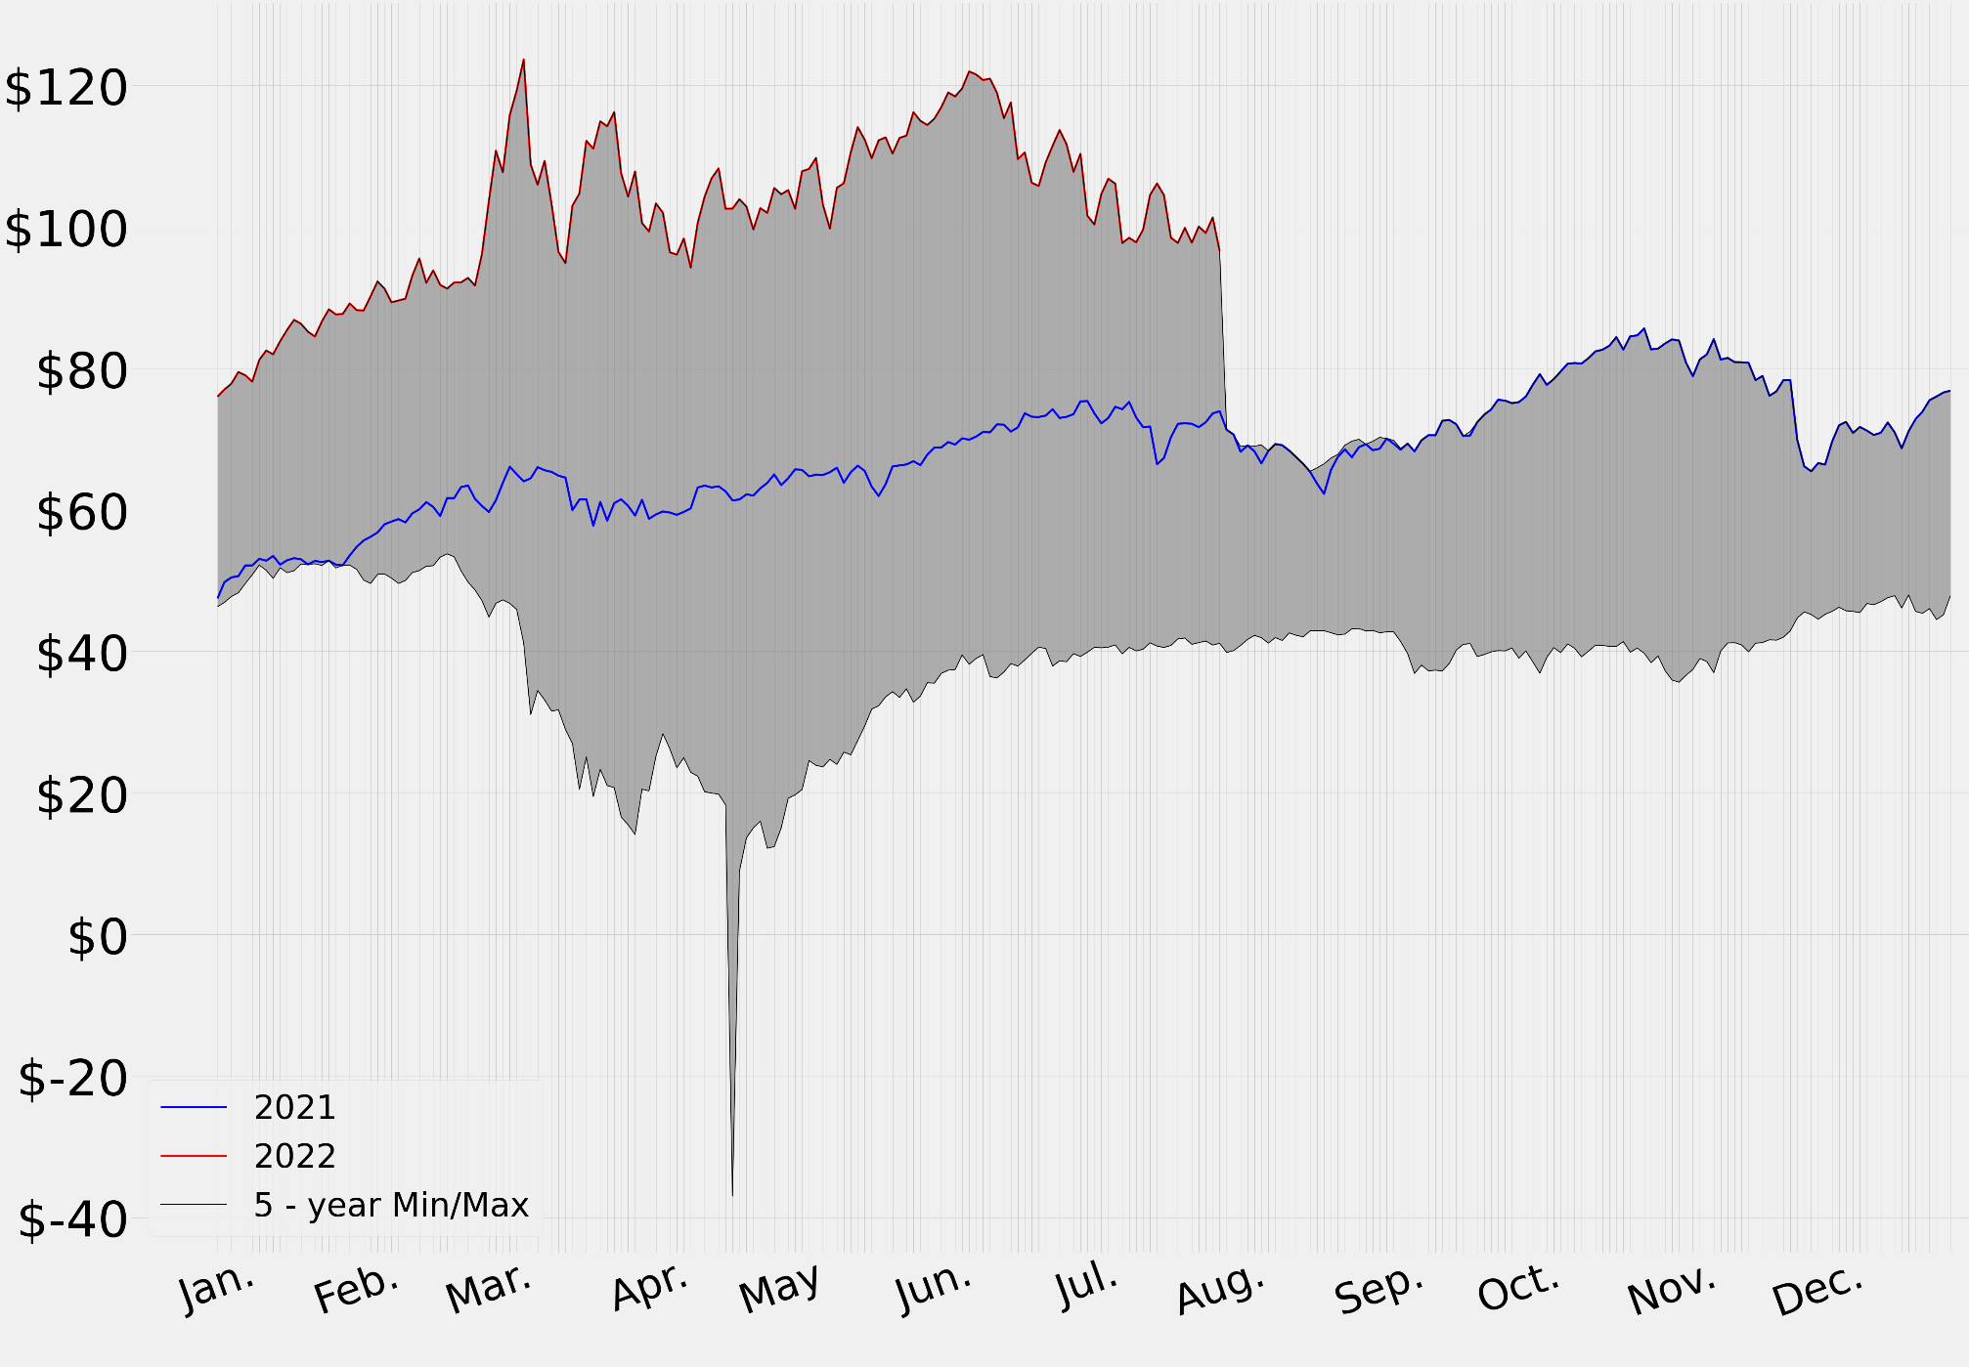
WTI Crude Oil Prices, $/BBL

Slide 8
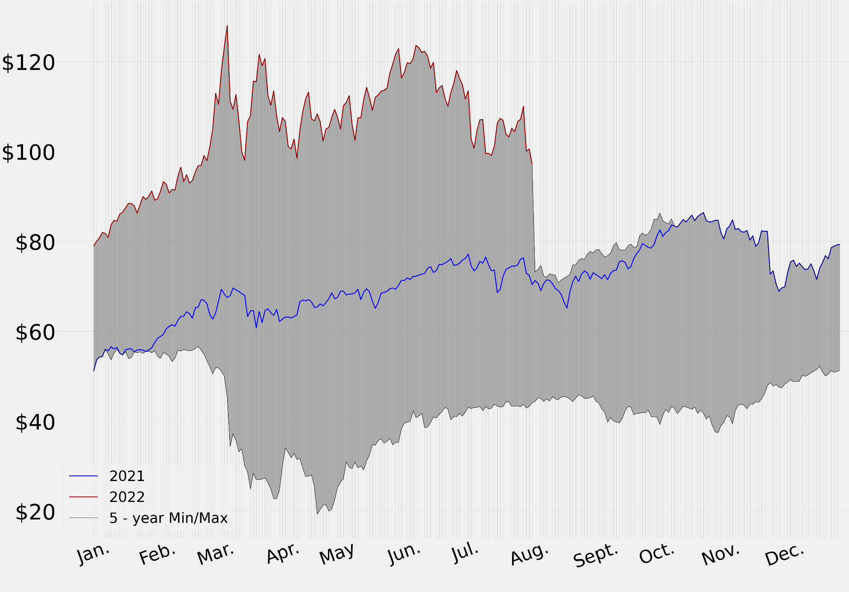
Brent Crude Oil Prices , $/BBL
Notes:
Russian Sanctions guarantees Brent/European crude goes over $100 / bbl. Market is already undersupplied. Current market conditions serve Putin well that Europe does not want a conflict and would allow Russian movement into Ukraine. Energy export ban to Europe undesirable by Europe.

Slide 9
WTI Spot & Forward Curve, $/BBL
Notes:
Updated for Aug. 2022

Slide 10
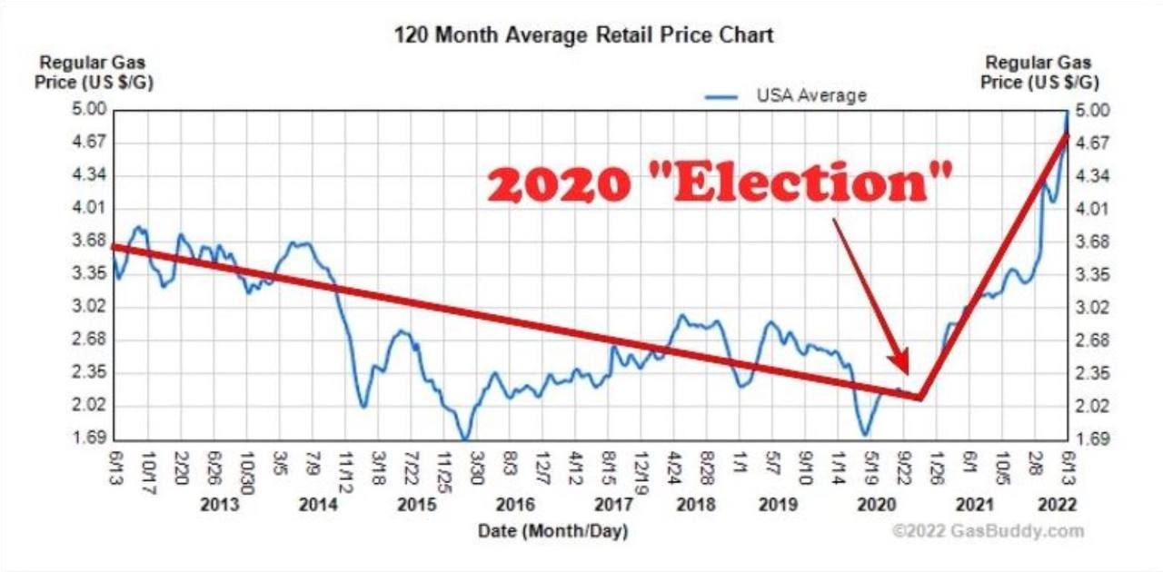

Slide 11
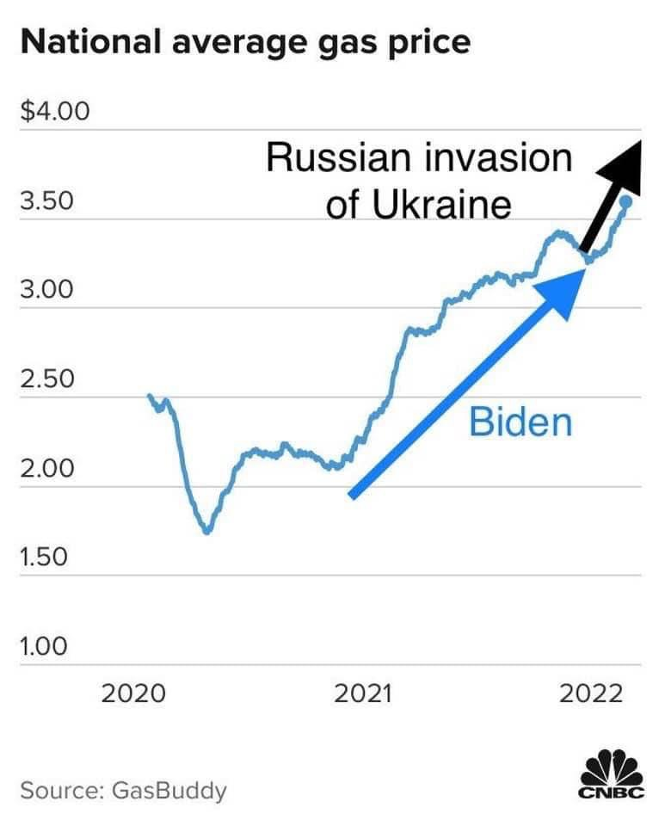

Slide 12
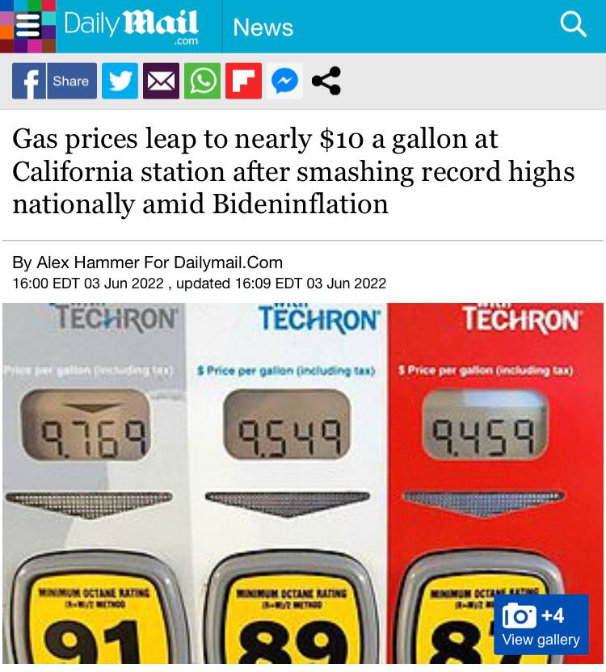

Slide 13
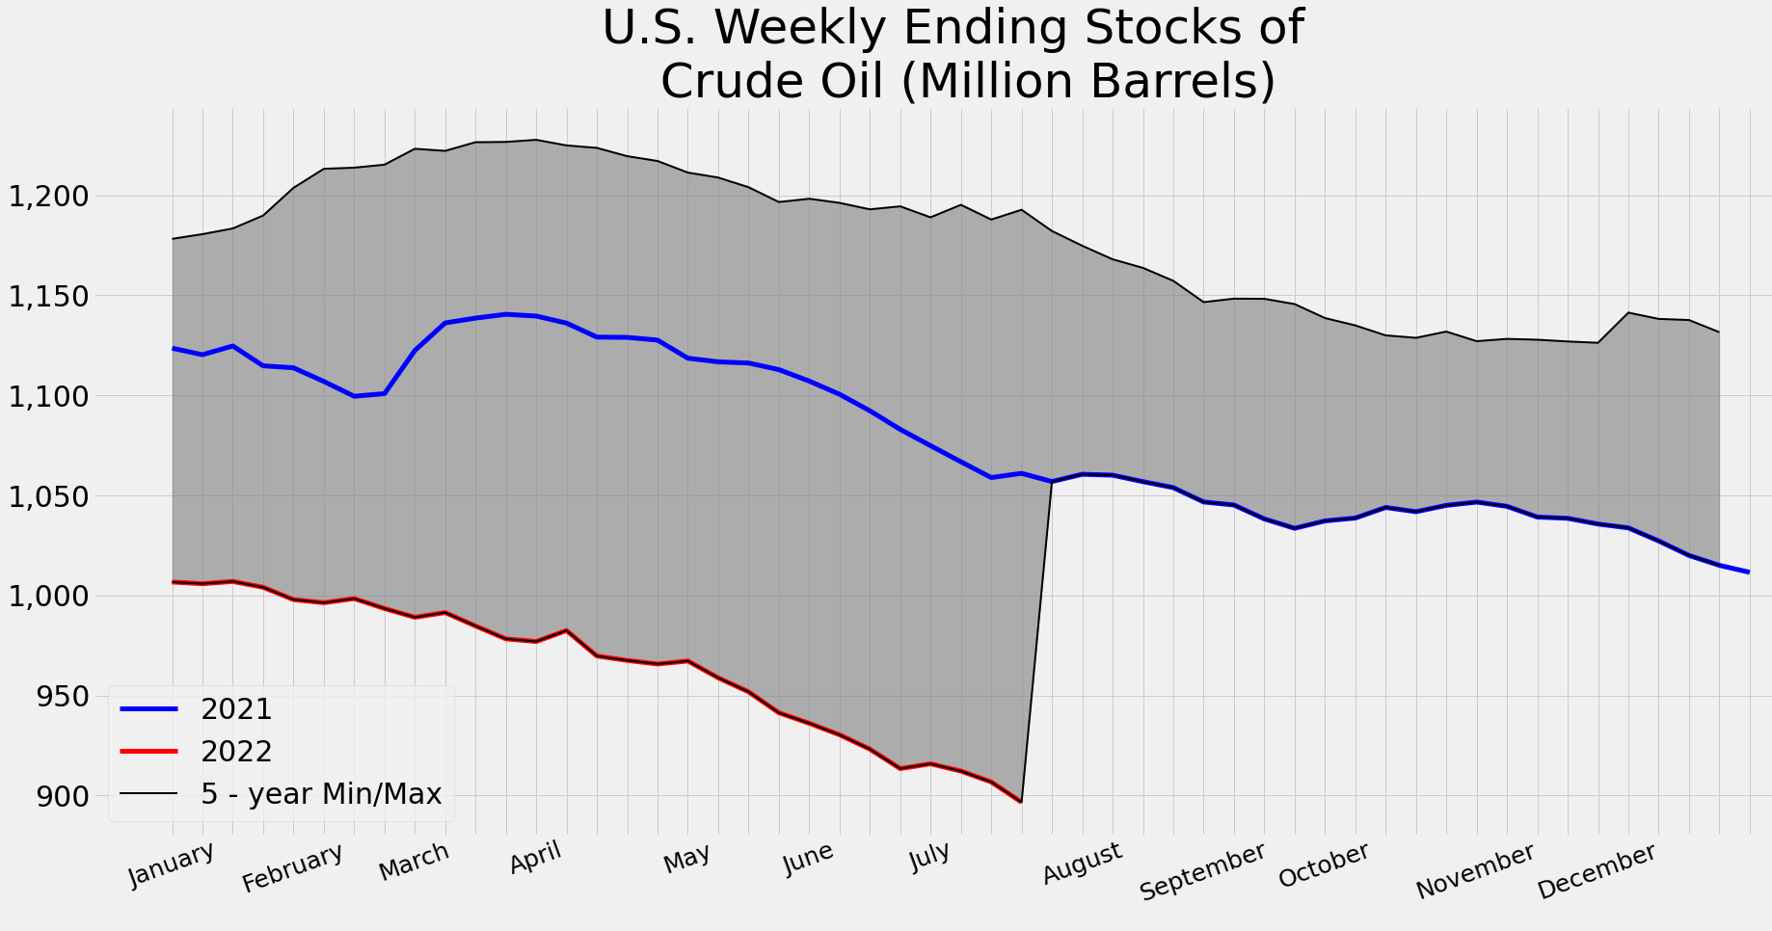
Notes:
Note: Updated for August 2022

Slide 14
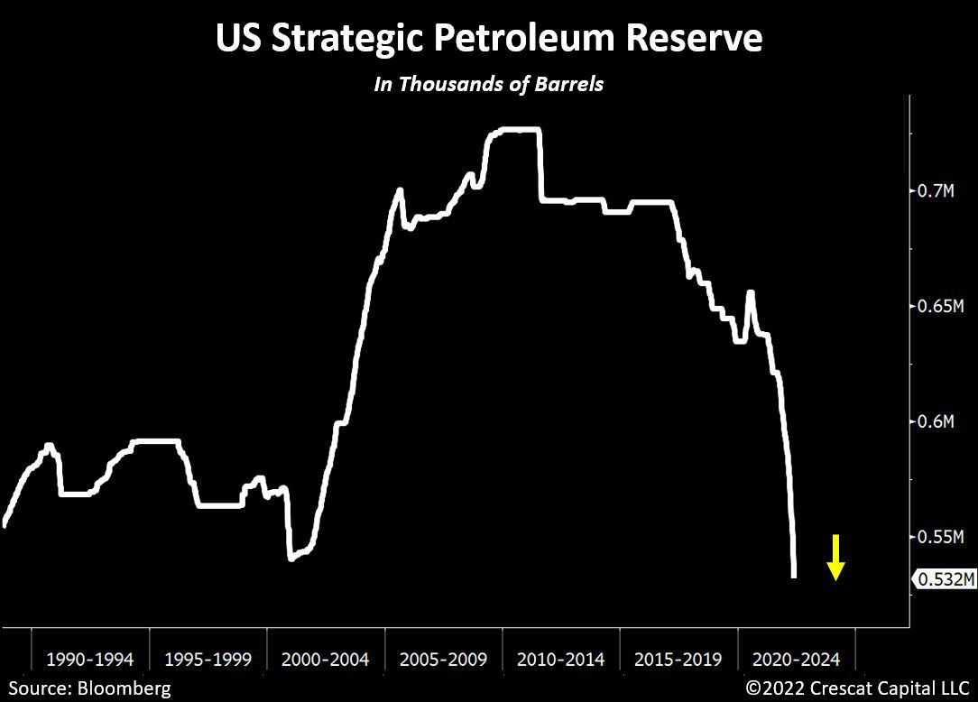
Notes:
Updated for Aug 2022
4/20: U.S. crude stockpiles slump as export surge to more than 2-yr high - EIA
U.S. crude stockpiles slump as export surge to more than 2-yr high - EIA (Reuters)
U.S. crude stockpiles fell sharply last week due to a surge in exports to a more than a two-year high, while production neared pre-pandemic levels, the Energy Information Administration said on Wednesday.
Crude inventories fell by 8 million barrels in the week ended April 15 to 413.7 million barrels, compared with analysts' expectations in a Reuters poll for a 2.5 million-barrel rise.
"Strong exports have been driven by a pull to Europe and we should expect strength in the weeks ahead," said Matt Smith, lead Americas analyst at Kpler.
That was driven by a surge in exports, which rose to 4.3 million barrels per day in the most recent week, the most since March 2020, while imports fell to their lowest since April 2021, a reflection of worldwide demand for crude as Russian exports have fallen since its invasion of Ukraine in February.
Those exports offset an injection of 4.7 million barrels from U.S. strategic reserves as part of the White House's efforts to lower fuel prices overall.
U.S. production rose, hitting 11.9 million bpd, its highest since May 2020, at a point when oil companies were starting to reduce output in response to the worsening of the coronavirus pandemic.
Refinery crude runs rose by 194,000 bpd last week, increasing refinery utilization rates by 1 percentage point to 91%of total capacity.
That came even as overall demand has slipped somewhat in the United States, as product supplied, a measure of demand, fell to its lowest on a four-week moving basis since June last year.
U.S. gasoline stocks fell by 761,000 barrels in the week to 232.4 million barrels. Distillate stockpiles, which include diesel and heating oil, fell by 2.7 million barrels to 108.7 million barrels, hitting levels not seen since May 2008.
Oil prices rose on the data, with U.S. crude futures gaining $1.07 to $103.63 a barrel, while Brent added 75 cents to $107.98 a barrel.
This table in a time slide:

Slide 15
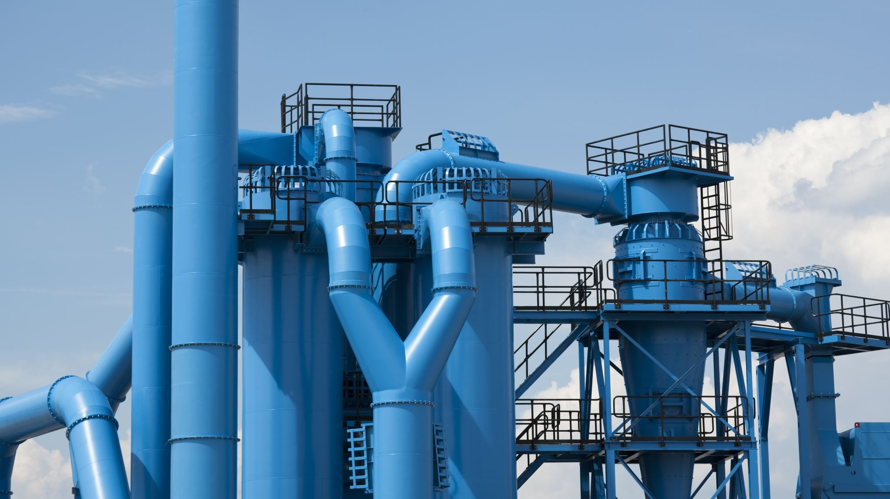
Refining and Refining Margins

Slide 16
Notes:
Updated for Aug 2022
4/20: U.S. crude stockpiles slump as export surge to more than 2-yr high - EIA
U.S. crude stockpiles slump as export surge to more than 2-yr high - EIA (Reuters)
U.S. crude stockpiles fell sharply last week due to a surge in exports to a more than a two-year high, while production neared pre-pandemic levels, the Energy Information Administration said on Wednesday.
Crude inventories fell by 8 million barrels in the week ended April 15 to 413.7 million barrels, compared with analysts' expectations in a Reuters poll for a 2.5 million-barrel rise.
"Strong exports have been driven by a pull to Europe and we should expect strength in the weeks ahead," said Matt Smith, lead Americas analyst at Kpler.
That was driven by a surge in exports, which rose to 4.3 million barrels per day in the most recent week, the most since March 2020, while imports fell to their lowest since April 2021, a reflection of worldwide demand for crude as Russian exports have fallen since its invasion of Ukraine in February.
Those exports offset an injection of 4.7 million barrels from U.S. strategic reserves as part of the White House's efforts to lower fuel prices overall.
U.S. production rose, hitting 11.9 million bpd, its highest since May 2020, at a point when oil companies were starting to reduce output in response to the worsening of the coronavirus pandemic.
Refinery crude runs rose by 194,000 bpd last week, increasing refinery utilization rates by 1 percentage point to 91%of total capacity.
That came even as overall demand has slipped somewhat in the United States, as product supplied, a measure of demand, fell to its lowest on a four-week moving basis since June last year.
U.S. gasoline stocks fell by 761,000 barrels in the week to 232.4 million barrels. Distillate stockpiles, which include diesel and heating oil, fell by 2.7 million barrels to 108.7 million barrels, hitting levels not seen since May 2008.
Oil prices rose on the data, with U.S. crude futures gaining $1.07 to $103.63 a barrel, while Brent added 75 cents to $107.98 a barrel.
This table in a time slide:

Slide 17
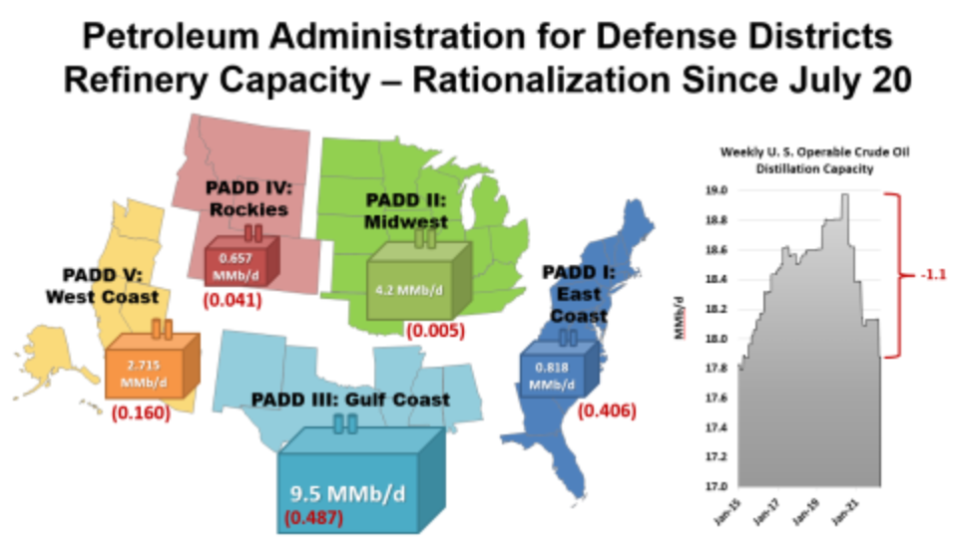
Notes:
4/25: Refinery Shut-Downs Continue with LyondellBasell
Lyondell Bassell became the latest refiner to announce a closure of its refinery last Thursday, when the company said that it would shutter operations at its 268 Mb/d refinery in Houston, Texas. The announced closure comes after two recent failed attempts to sell the refinery. The company is exiting the refining business and the Houston operation no longer fits their strategic goals as a global petrochemical production business.
Since July of 2020, 1.1 MMb/d of refining capacity has been lost, with most of that (5 MMb/d) in PADD III. The Lyondell Bassell announcement will add to that number.

Slide 18
Set the Stage (Natural Gas)
2018 - 2019
NG prices between $2-$3
Mid-stream focus to rerouting pipelines for export
Mexico & LNG demand increasing
2020
COVID - 10% decrease in production
LNG Demand
World shifts in June 2020
Prices move above $3.00
2021
June 2021

Slide 19
Russian Share of European: Natural Gas (40%) Oil (25%) Russian Share of World Natural Gas (17%) Oil (12%)

Slide 20
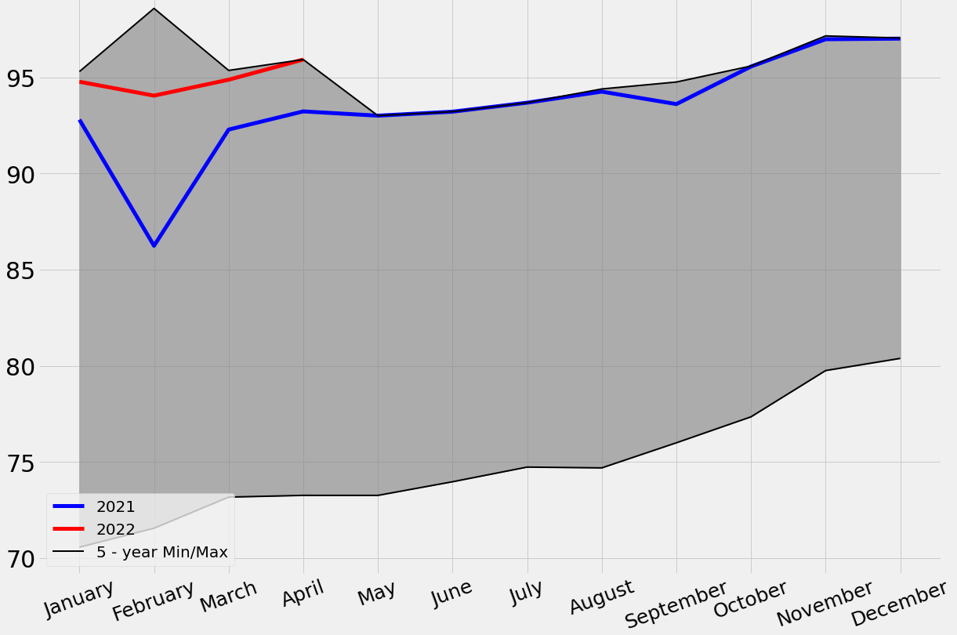
Monthly US Natural Gas Production, BCF/day
Notes:
Fixed for AUG 2022

Slide 21
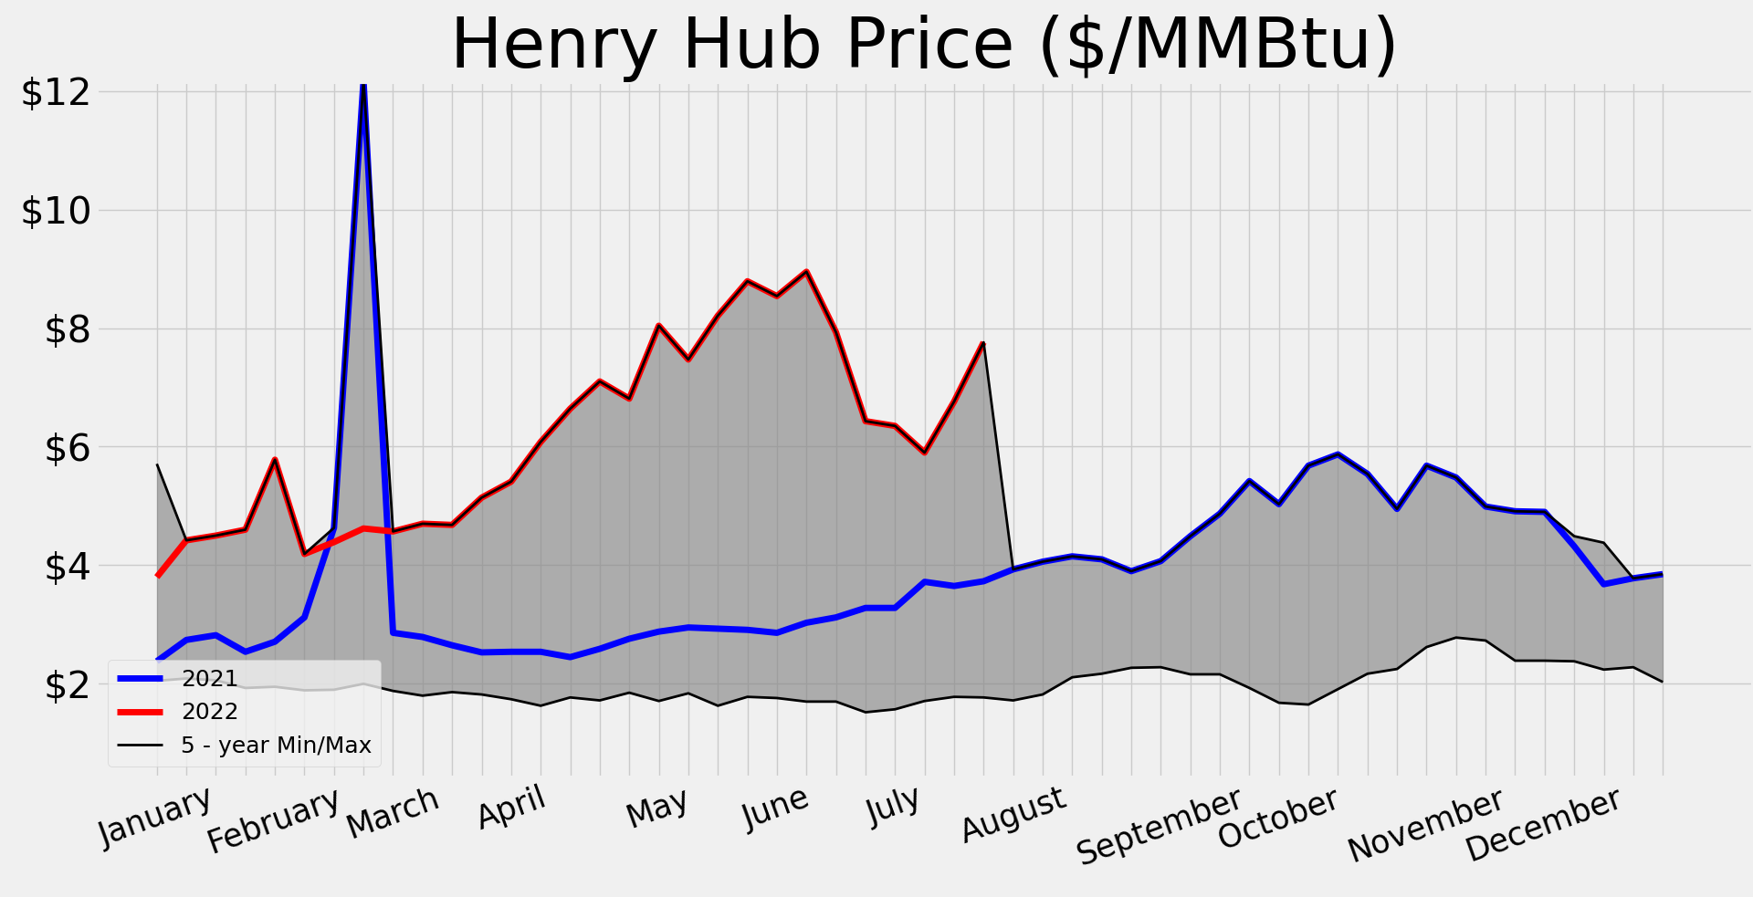
Notes:
Updated for AUG 2022

Slide 22
Natural Gas Forward Curve, $/mmBTU
Notes:
Updated for AUG 2022

Slide 23
LNG Prices, $/mmBTU
Notes:
Updated for Aug 2022
TTF is over $30/mmBTU b/c Ukraine uncertainty (18% increase in one day). Russian supply to Europe = 25% NG imports. Disruption represents 30 mcm/d (1 BCF)/d or 1/3 standard LNG cargo per day.
Europe Power Prices
50% of Euro gas comes from Russia. 50% from LNG. Storage shutdown.

Slide 24
LNG Profit Spread, $/mmBTU
Notes:
Euro need for NG. Now approved as green in Europe.

Slide 25
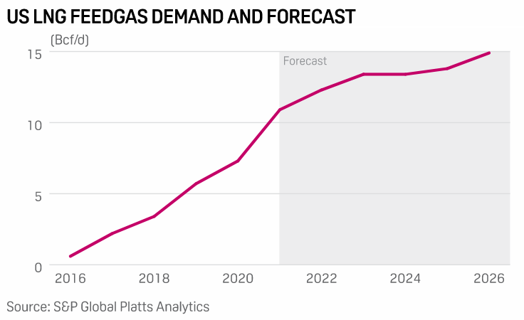
LNG Export Capacity Increases in US, BCF/d
Notes:
Biden recently demanded industry to increase LNG export to 15 BCF/D to help Europe. Note form parenting: Always demand what kids are already doing. Current taeget in industry is to expand to 30 BCF/D of output

Slide 26
% LNG Exported of Total Production
Notes:
Updated for Aug 2022
LNG increases to 15% of production unless drilling/production increases. At current prices, assume they will.

Slide 27
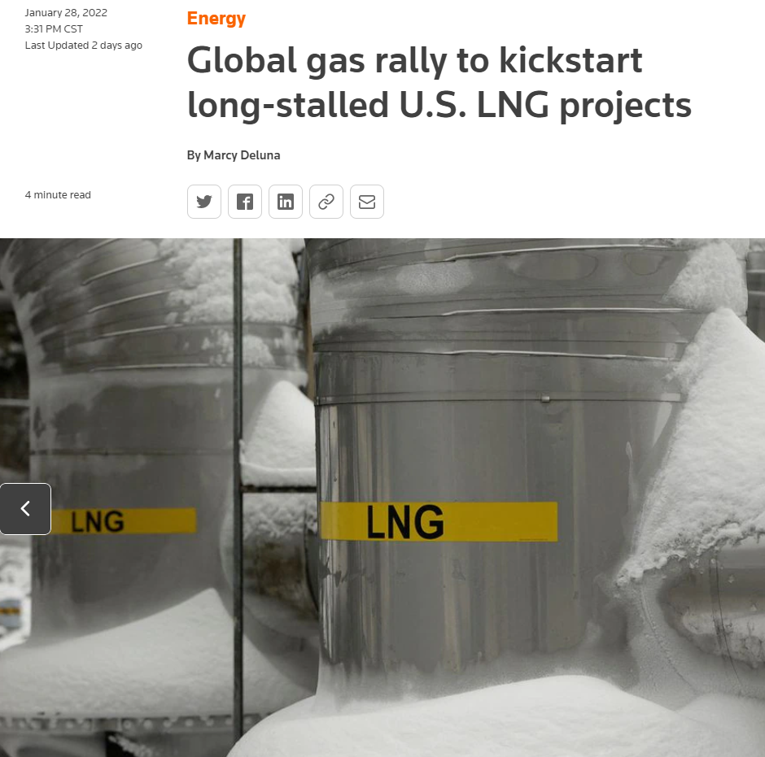
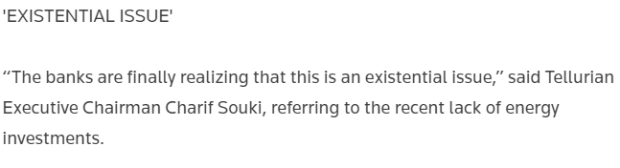
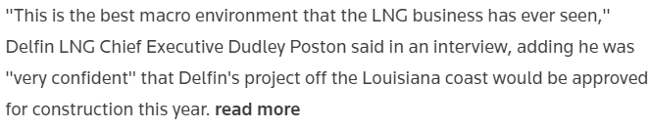

Slide 28
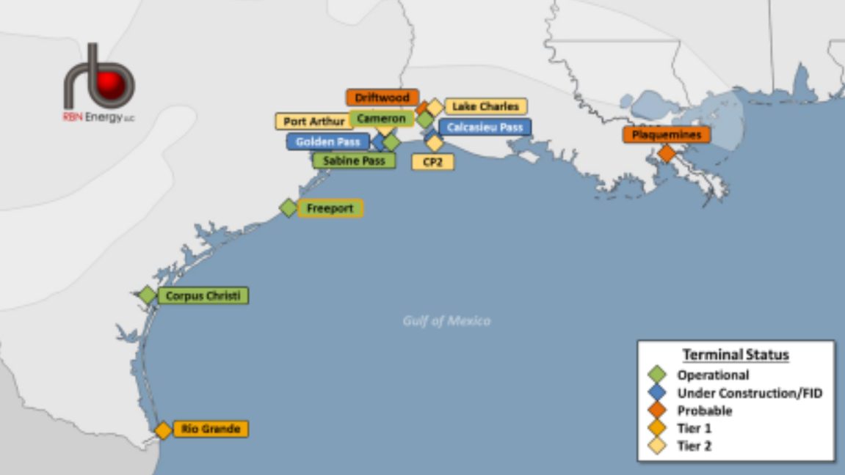

Slide 29
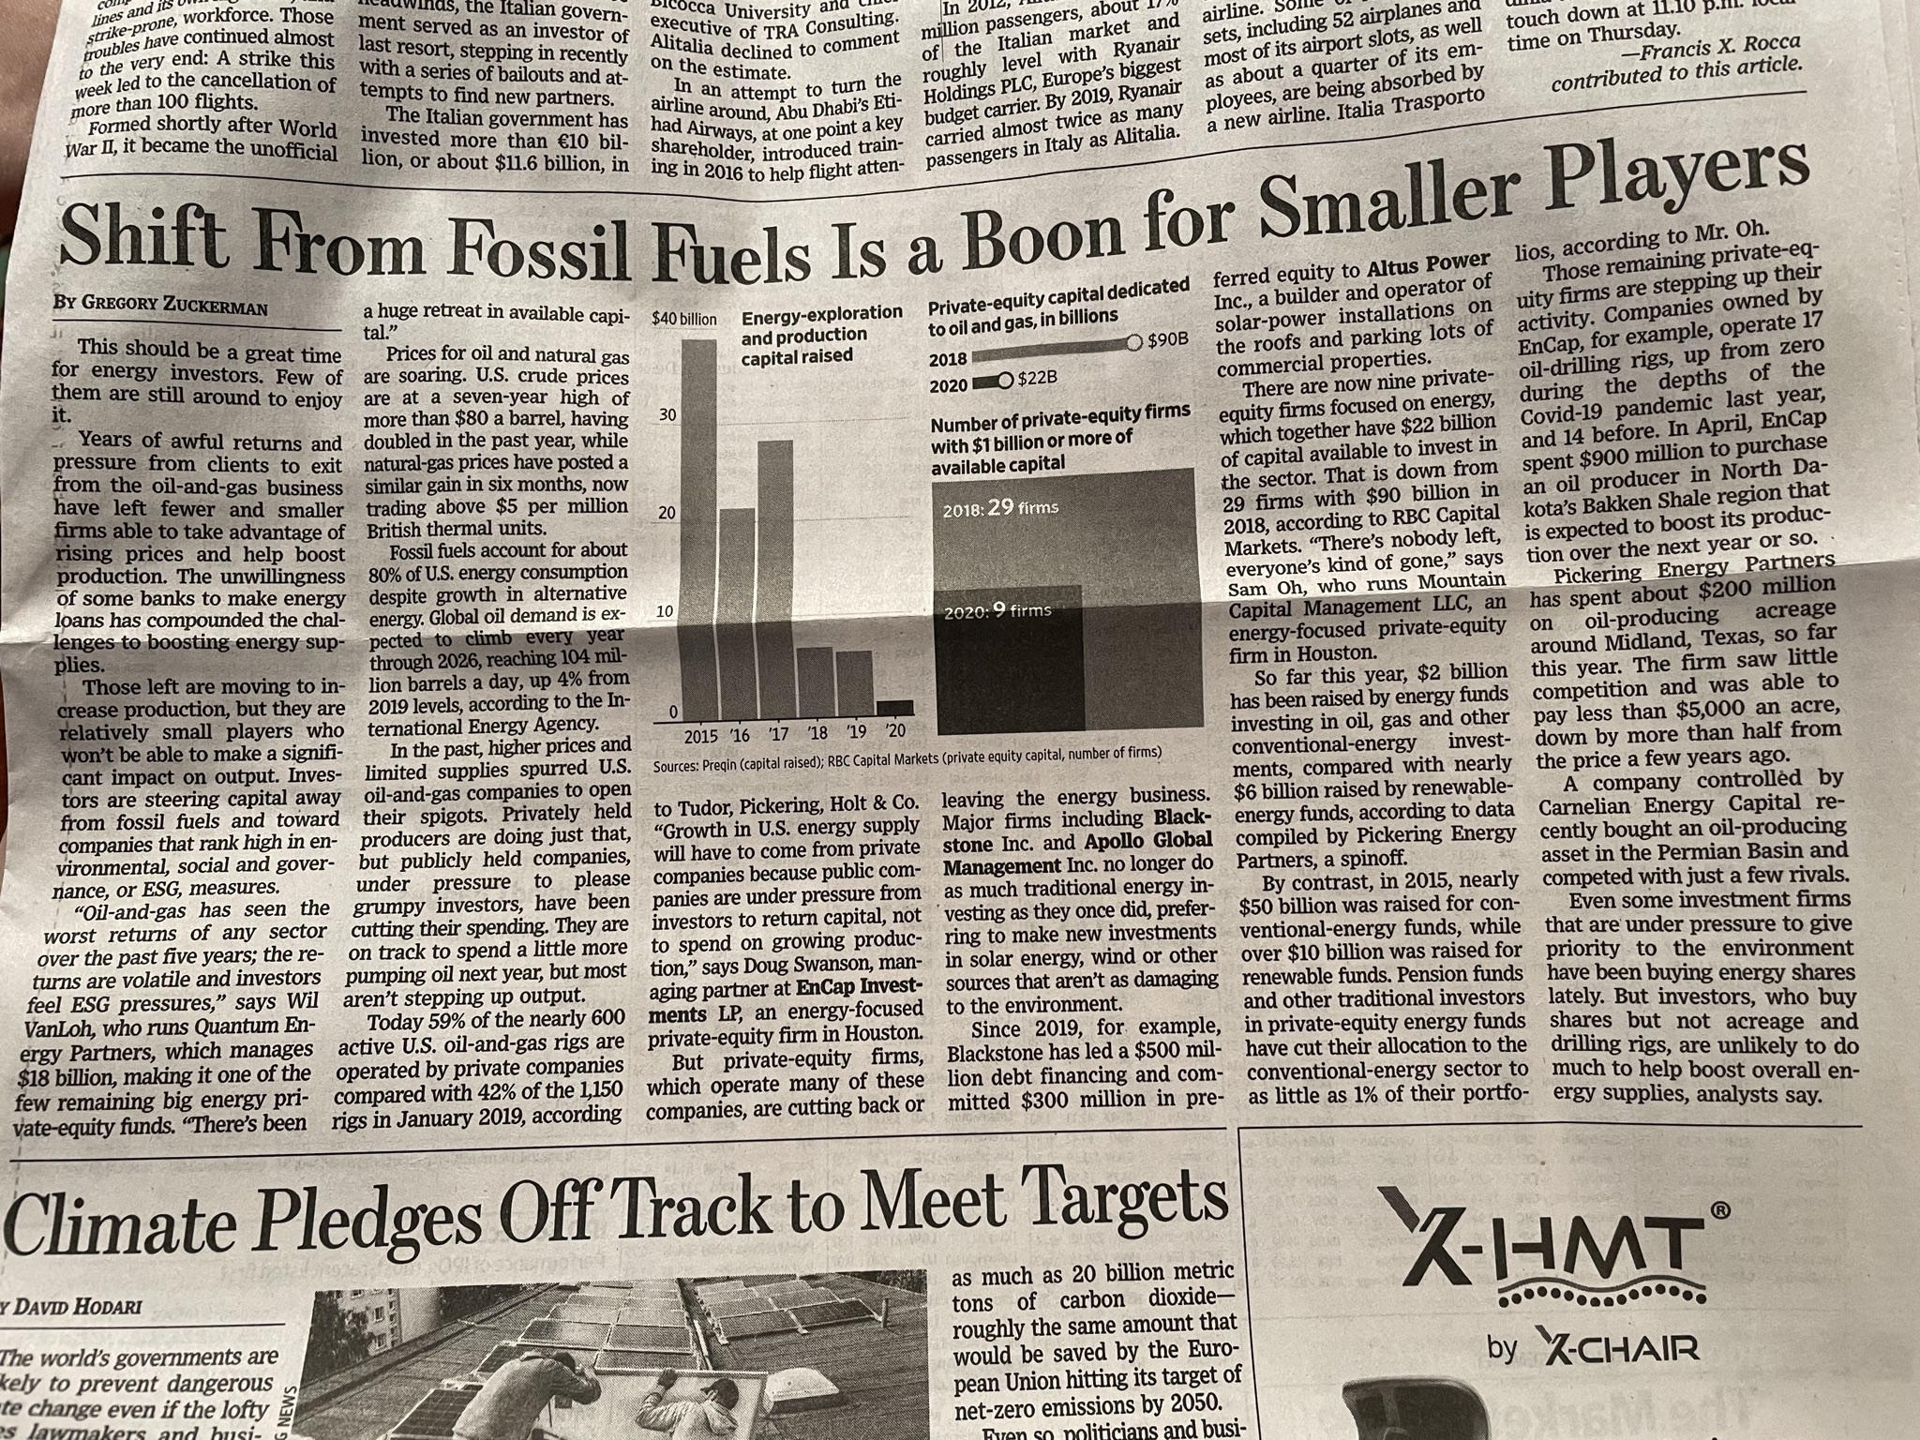
Where is the Producer Response?

Slide 30
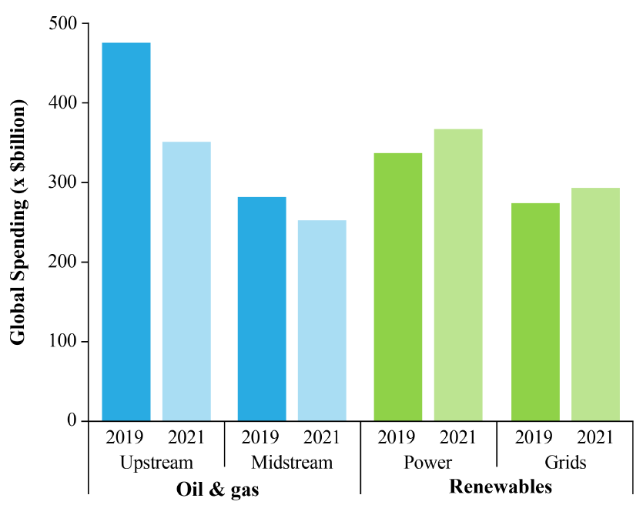
Global Spending Shifts

Slide 31
Oil & Gas Discoveries

Slide 32
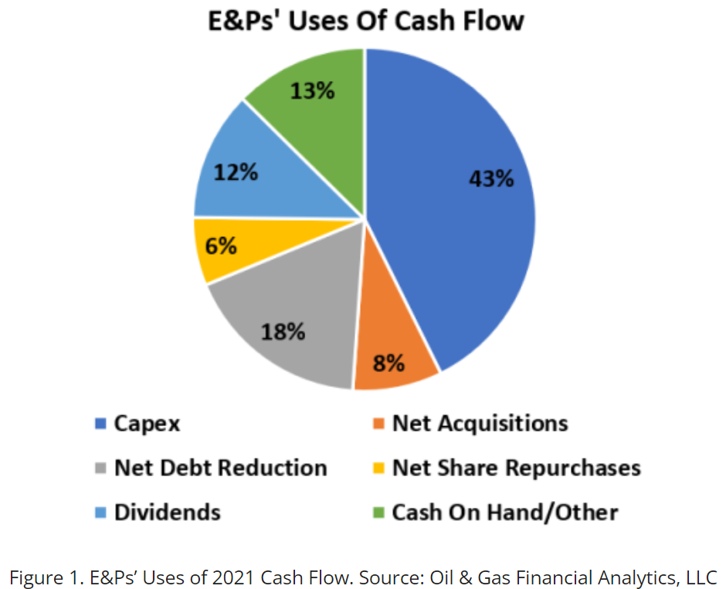
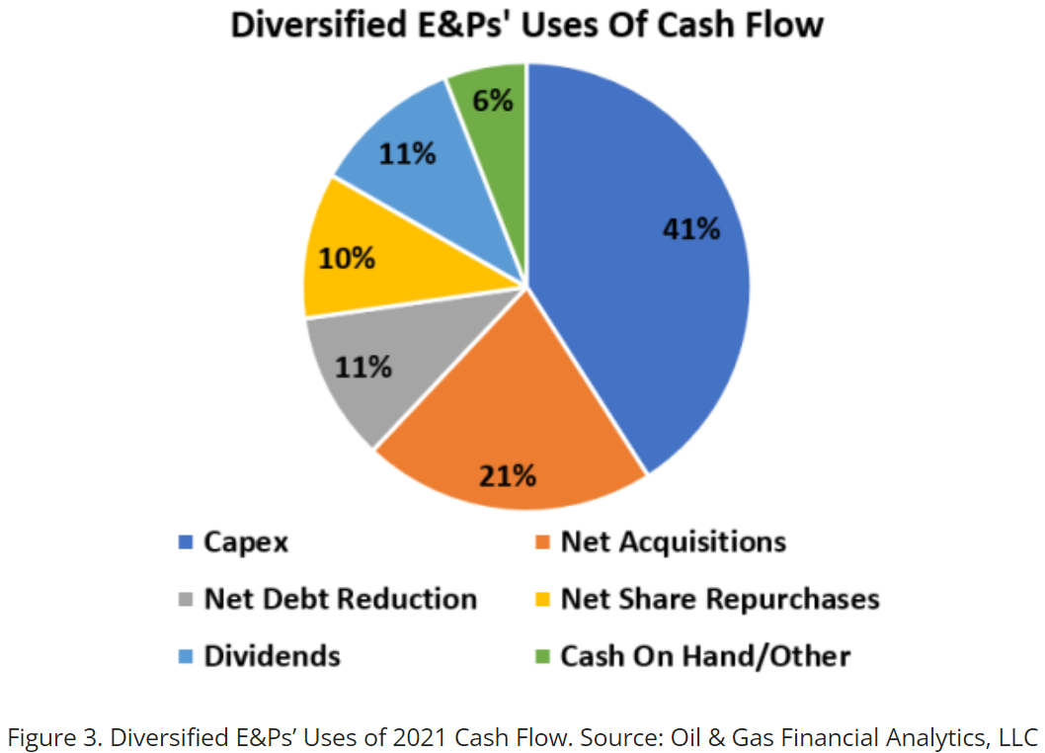
E&P VS Integrated E&P Cashflows
Notes:
Share buyback and dividend programs have been effective. Share prices have doubled. Private Equity is back to (silently) courting E&P
Prediction is
Rig Count affectd by supply chain availability of drilling tools
rig count growth rate will start to increase in H2 of the year
Acquisitions will be strong by majors and larger independents
Green investments will increase, but E&P production & revenue will out-perform quietly.
EX. Major: $1B in solar & $5B in E&P.
Majors will acquire successful “green programs”

Slide 33
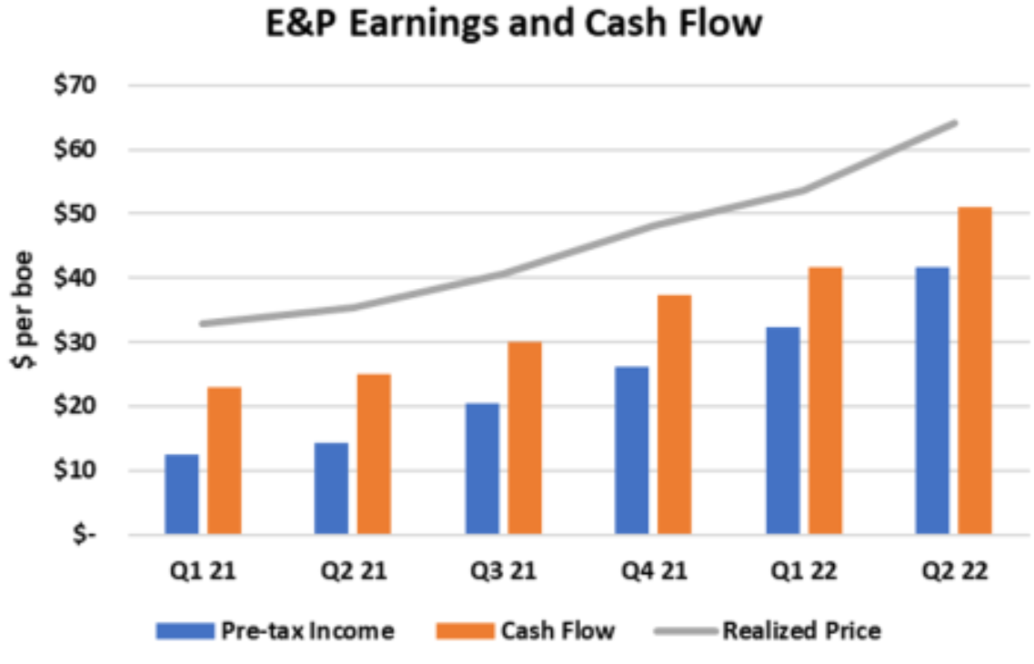
RBN Energy

Slide 34
Therefore….
Share buyback and dividend programs have been effective.
Refining & E&P shares had tremendous returns in 2021.
Private Equity is back to (silently) courting private E&P firms
The best cure for high prices is …
Notes:
Note: Biden Inflation bill has tax on companies buying back stocks

